Slide 1

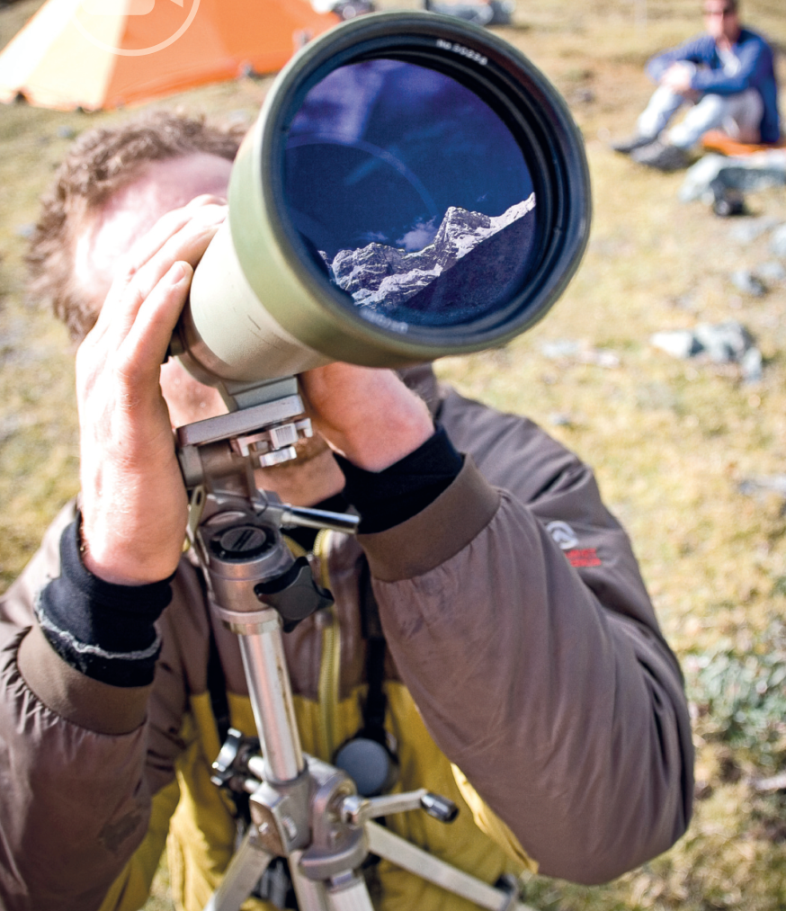
8f Questions and answers
Before you watch
1 You’re going to watch two videos in which National Geographic Explorers give their personal answers to questions. Before you watch, discuss these questions.
1 What kind of work do explorers do? Where do they work?
2 What items might they need to take with them when they’re exploring?
3 Why do you think people become explorers?
See next slide for answers
Cory Richards on the Cordillera Blanca in Peru
8f-p. 103

Slide 2
Exercise 1
EXAMPLE ANSWERS
1 They travel the world and go to places other people don’t go to. They do research, they find out about unknown areas, and they are often involved with the conservation of plants, wildlife, and the way of life of traditional people and their languages. They take photos and make films. They often work outdoors in dangerous and inhospitable places.
2 Items: cameras, binoculars, good boots, climbing equipment, waterproof clothing, maps, GPS systems, sunglasses, knife, camping and/or survival equipment.
3 To see the world, because they have a sense of adventure, to get away from ordinary life, to pursue their interest in science or geography or geology, to help protect and conserve the environment.

Slide 3
2 Key vocabulary
a Read the sentences. The words in bold are used in the video. Guess the meaning of the words.
1 If you want to watch animals in the wild, a pair of binoculars is very useful.
2 I’d get really burned if I didn’t use sunblock.
3 I’m not very good with a paintbrush – I prefer doing pencil drawings.
4 All children are curious about the world around them.
5 I’ve been making good progress in Italian since I started classes.
b Match the words in bold in Exercise 2a with these definitions.
3
2
1
5
4
a a tool to paint with
b cream that protects your skin from the sun
c equipment with lenses for looking at things far away
d improvement and development
e interested in something and wanting to learn about it
8f-p. 102

Slide 4

While you watch
Video 8.1
Video 1: What item would you not leave home without?
3 Read what four of the explorers say about why they chose the items they take with them. What do you think they are talking about?
Students’ own ideas at this stage
1 Carlton Ward, photographer
‘without a _______________, we’d still be paddling in circles somewhere’
2 Amy Dickman, zoologist
‘_______________, just to have a break at the end of the day’
3 Chris Thornton, archaeologist
‘_______________. I’m very, very white.’
4 Cory Richards, photographer
‘a _________________ to record what I’m experiencing’
4 Watch the video. Check your ideas from Exercise 3.
1 GPS
2 DVDs
3 sunblock
4 pencil / camera / paintbrush / vehicle / way
8f-p. 103

Slide 5

5 Watch the video again. Tick the items the explorers mention.
Video 8.1
camera
binoculars
knife
GPS
DVDs
headlamp
hat
sunblock
local person
pencil
paintbrush
6 Work in pairs. Which of the items in Exercise 5 surprised you? Did the explorers mention any of the items you discussed in Exercise 1 question 2?
Students’ own answers
8f-p. 103

Slide 6
Videoscript
Questions and answers
0.00–0.13 ‘Uh, the one thing I wouldn’t leave home without …’
‘Mmm, eh …’
‘That’s a good question.’
‘Phew.’
0.14–0.19 John Francis, ecologist You know, when I’m packing if I don’t have a camera or my binoculars then I feel nude.
0.20–0.24 Andrés Ruzo, geologist I’ve got a habit of carrying like a rosary and a knife.
0.25–0.30 Carlton Ward, photographer My GPS. Without a GPS, we would be still paddling in circles somewhere.
0.31–0.40 Amy Dickman, zoologist I always take DVDs. It’s very sad, but it just gives me something to look at that’s nothing to do with the field and just have a break at the end of the day.
0.41–0.49 Eric Patterson There’s a lot of times where the power goes out. My headlamp has become sort of an essential tool even though I might not have thought so at first.
0.50–0.59 Lee Berger, paleoanthropologist It’s my hat. I’ve got a hat that I wear all the time and I wouldn’t … It’s my lucky hat and so I make my discoveries with my hat on.
1.00–1.03 Chris Thornton, archaeologist Sun block. I am very, very white.
1.04–1.06 Kuenga Wangmo, archaeologist I wear this … It’s supposed to protect you.
1.07–1.14 Aziz Abu Sarah, humanitarian Items – I don’t care about anything. I need to make sure I have a local with me. That’s the one thing I would never give up on.
1.15–1.26 Cory Richards, photographer You don’t want to leave home without a pencil, a camera, a paintbrush. One thing I would not leave home without is a vehicle or a way to record that which I am experiencing.

Slide 7

Video 2: Why is it important to explore?
Video 8.2
7 Read what the explorers in the video say. What do you think the missing word is? Then watch the video and check your ideas.
1 John Francis, ecologist
‘If you have _________________ and you don’t pursue them, then to me it’s a life unlived.’
2 Laly Lichtenfeld, big cat conservationist
‘It keeps _________________ exciting, I mean that’s what exploring is about.’
3 Enric Sala, marine ecologist
‘Without exploration, there would be no _________________ .’
4 Lee Berger, paleoanthropologist
‘We think we _________________ how things work, but we don’t.’
questions
life
progress
understand
8 Watch the video again. Who gave the most interesting answer, in your opinion?
Students' own ideas
8f-p. 103

Slide 8
Videoscript
Questions and answers
0.00–0.07 Lee Berger, paleoanthropologist Oh … I … that’s not hard to say.
0.08–0.09 Catherine Workman, conservation biologist Mmmm, that’s tough.
0.10–0.14 Laly Lichtenfeld, big cat conservationist Mmmm, let me think about that one for a minute.
0.15–0.25 John Francis, ecologist Exploration is in people’s blood – some more than others, I think. But if you have questions and you don’t pursue them, then to me it’s a life unlived.
0.26–0.32 Emily Ainsworth, anthropologist It’s part of human nature to be curious and to want to learn more about the world.
0.33–0.38 Juan Martinez, environmentalist It’s where you find yourself, or you find new things, where you grow.
0.39–0.42 Laly Lichtenfeld It keeps life exciting. I mean that’s what exploring is about.
0.43–0.50 Clare Fieseler, marine ecologist That’s what drives people to the highest mountain and the deepest crevices and I don’t think that will ever stop.
0.51–1.02 Enric Sala, marine ecologist Without exploration, there would be no progress. Exploration is trying to learn why and how and where.
1.03–1.17 Lee Berger We think we know this place, but we don’t. We think we know ourselves, but we don’t. We think we understand how things work, but we don’t.
1.18–1.23 Catherine Workman By knowing what’s out there, we care about what’s out there.
1.24–1.33 Cory Richards If we have more to care about, then we engage more fully with our world and more fully with our human family and we act, you know, with love.
1.34–1.37 Lee Berger That’s why exploration is so fundamentally important.

Slide 9

After you watch
9 Vocabulary in context
a Watch the clips from the videos. Choose the correct meaning of the words and phrases.
b Answer the questions in your own words. Then work in pairs and compare your answers.
1 Does the power ever go out where you live? What do you do when that happens?
2 Do you think it’s human nature to be curious? What else is human nature?
3 What kind of thing do you think drives artists and business people?
EXAMPLE ANSWERS
1 Students’ own ideas
2 It is human nature to fall in love, to have ambitions, to get angry.
3 Artists: desire to create something, to be famous.
Business people: desire to be rich, to lead people.
8f-p. 103

Slide 10
Videoscript
Questions and answers
c
b
c
b
a
1 There’s a lot of times when the power goes out.
a I’m really tired
b there’s no petrol
c we have no electricity
2 I need to make sure I have a local with me.
a a map of the area
b a person from the area I’m in
c a place to stay
3 It’s part of human nature to be curious …
a experiencing wild places
b our education
c the way we are
4 It’s where you find yourself, where you find new things, where you grow.
a feel happy
b understand who you really are
c want to live
5 That’s what drives people to the highest mountain …
a makes people want to go
b takes people in a car
c works as a driver for explorers
Video 8.3

Slide 11
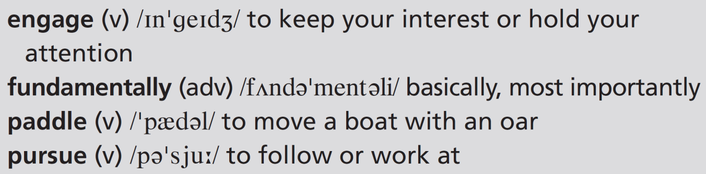
10 Work in pairs. Discuss the questions.
1 What would you not leave home without if you were travelling?
2 Why is it a good idea to travel?
EXAMPLE ANSWERS
Students’ own ideas
1 I wouldn’t leave home without my mobile phone because it’s a way of communicating with people, a GPS system to help me know where I am going, and a camera to record my journey.
2 It’s a good idea to travel because you see new places, meet new people, and find out what it is like to be in new places.
8f-p. 103

Slide 12
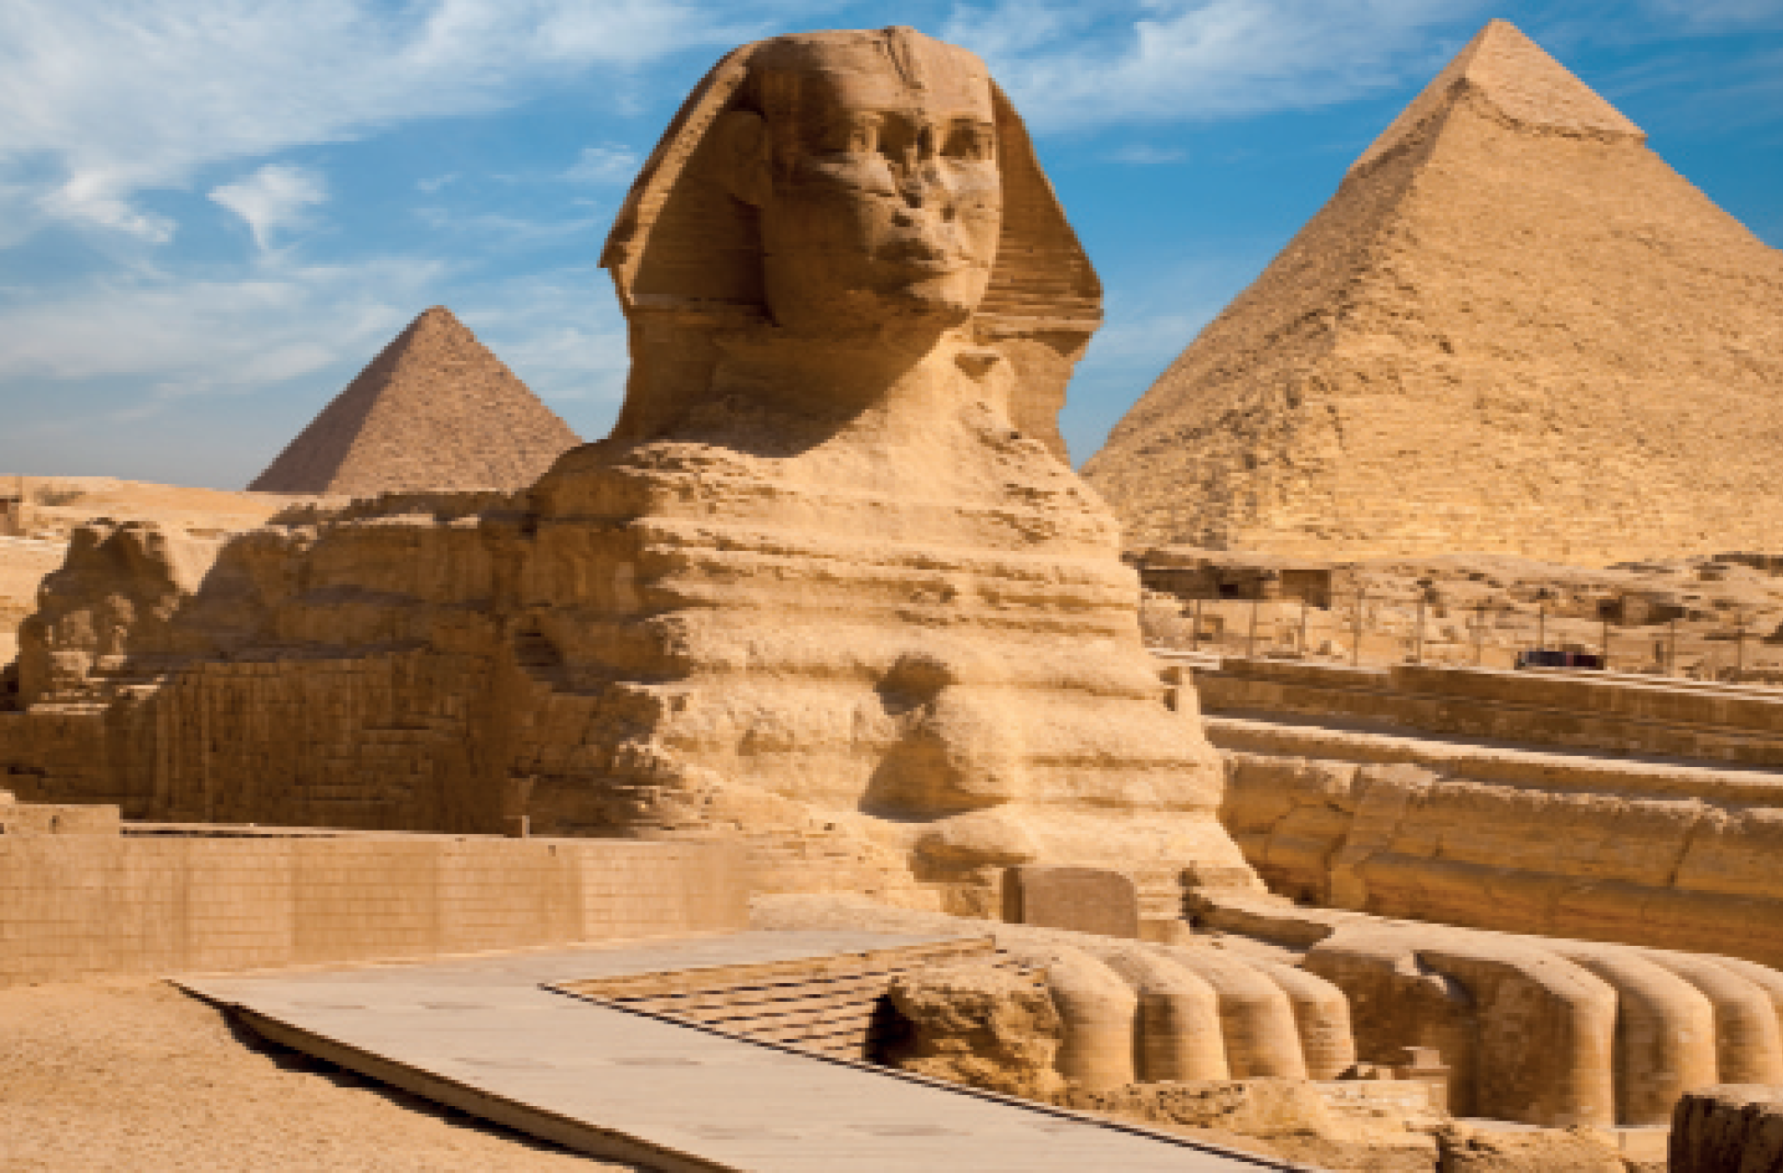
UNIT 8 REVIEW AND MEMORY BOOSTER
Grammar
1 Complete the article about Thomas Cook with the correct verb tense or form. Use the following: past simple, present perfect simple, present perfect continuous, -ing form or infinitive with to.
U8 Review-p. 104

Slide 13
Before 1872, people 1 ____________________ (not / travel) for pleasure very much. Then a man called Thomas Cook 2 ____________________ (change) everything when he 3 ____________________ (form) a travel agency, Thomas Cook & Son. Cook aimed 4 ____________________ (provide) educational and cultural tours. His son was successful in 5 ____________________ (expand) the business around the world. At first, foreign travel was expensive, but incomes 6 ____________________ (rise) since those days. Nowadays, many millions of ordinary people expect
7 ____________________ (go) on holiday at least once a year. In the twentieth century, holiday makers preferred 8 ____________________ (book) trips with travel agencies. For the last few years, travel agencies 9 ____________________ (struggle) because most people
10 ____________________ (make) their own plans online. Thomas Cook, however, is still one of the biggest travel companies in the world.
didn’t travel
changed
formed
to provide
expanding
have risen
to go
to book
have been struggling
have been making
U8 Review-p. 104

Slide 14
2 Answer the questions about the article in Exercise 1.
1 How has travel changed since the time of Thomas Cook?
2 Why do you think the travel agency Thomas Cook & Son was successful?
1 people didn’t travel for pleasure very much, now they do; foreign travel was expensive, now it isn’t; holidaymakers used to prefer booking trips with travel agencies, now many people make their own plans online
2 because incomes rose and ordinary people started travelling for pleasure; it offered organized educational and cultural tours that appealed to people; in recent years many millions of ordinary people now expect to have at least one holiday a year
U8 Review-p. 104

Slide 15

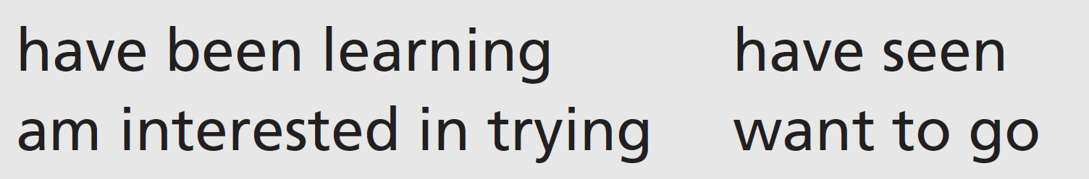
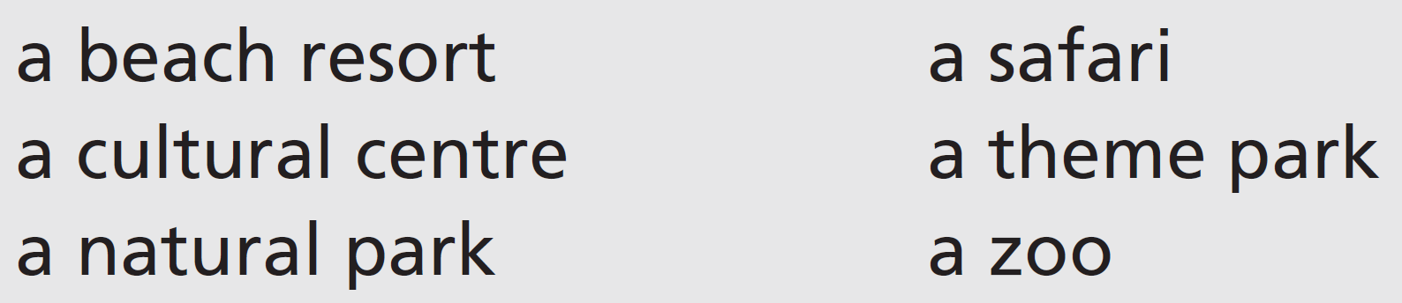
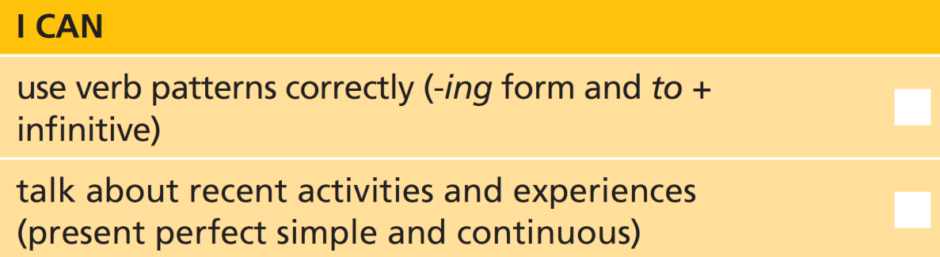
3 Write four true or false sentences about yourself with these verbs. Work in pairs and say if your partner’s sentences are true or false.
4 Work in pairs. Have you ever been to places like these on holiday? Ask and answer questions about your experiences.
U8 Review-p. 104

Slide 16
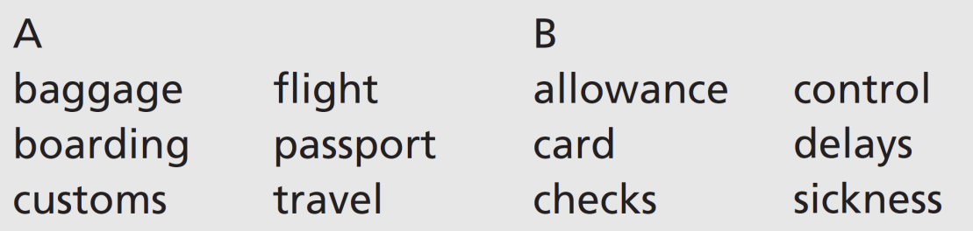
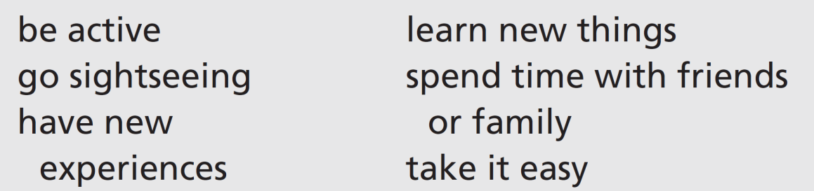
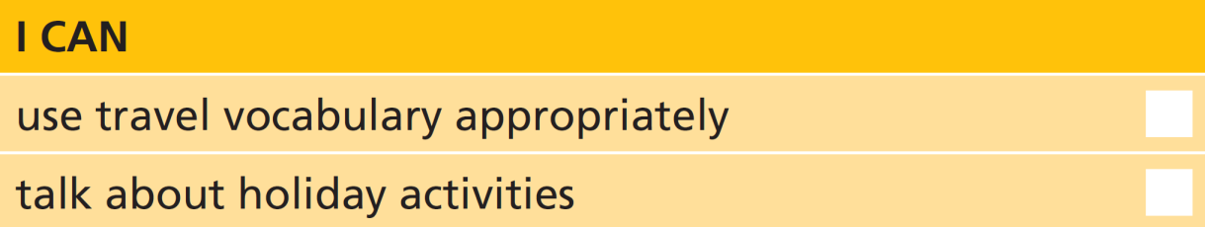
Vocabulary
5 Match nouns from A and B to make travel vocabulary. Then write questions with the expressions.
baggage allowance
boarding card
customs checks
flight delays
passport control
travel sickness/delays
6 Work in pairs. Which of these activities would you do in a seaside resort, a big city, a natural park and a campsite? Give your reasons.
Students’ own answers. You could do any of the activities in any of the places – it is mainly down to personal experience and preference.
U8 Review-p. 104

Slide 17
Real life
7 Read these sentences from a conversation at an airport. Put the sentences (a–h) in order (1–8).
3
6
7
1
8
5
2
4
a A: What? How has that happened?
b A: Well, let’s have another look. Calm down.
c A: Well, have you looked through all your pockets?
d A: Is anything wrong?
e B: Yes, I have. And I’ve checked the suitcase.
f B: I’ve been worrying so much about everything, and now this!
g B: I think I’ve lost the boarding passes.
h B: I don’t know. I thought they were in my pocket, but they aren’t there now.
U8 Review-p. 104

Slide 18

8 Work in pairs. Act out conversations similar to Exercise 7.
Conversation 1: Student A is a tourist and Student B is a tour guide. Student A has lost his/her passport.
Conversation 2: Student A is an airline official and Student B is a customer. The flight is cancelled.
U8 Review-p. 104

